Slide 1
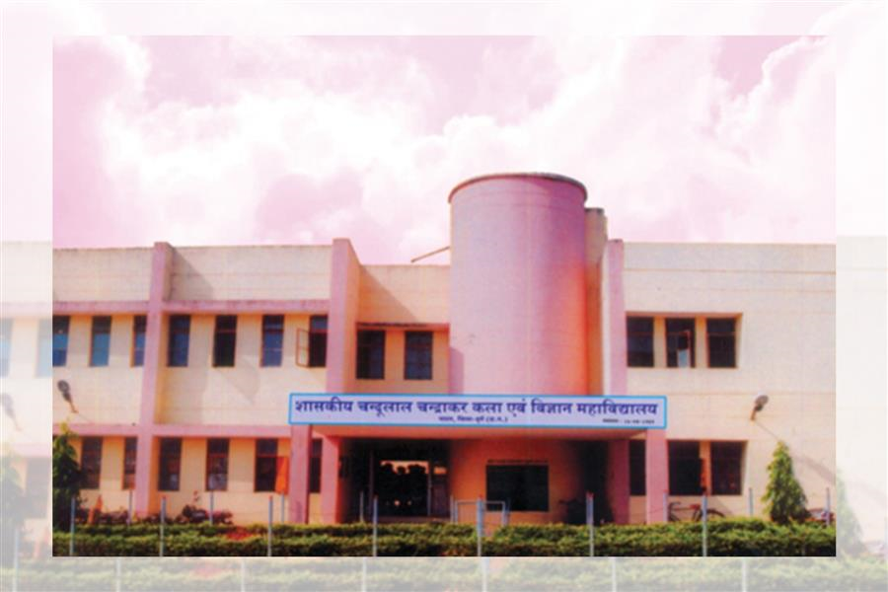
Department of Political science
Government Chandulal Chandrakar Arts and Science College, Patan , Durg.
Welcomes NAAC Peer Review Team Visit on 15th and 16th September.

Slide 2
contents
ABOUT THE DEPARTMENT
VISION, MISSION, GOALS, OBJECTIVES AND CORE VALUES
COURSE OUTCOME
PROGRAM OUTCOME
TEACHING METHODOLOGY
FUTURE PLANS
ENROLLMENT DETAILS AND RESULT ANALYSIS
ALUMNI
PROGRAM ORGANIZED AND MEMORABLE EVENTS

Slide 3
ABOUT THE DEPARTMENT
The college was established on 16th August 1989.
The UG program in the department started in the session 1989-90.
The PG program in the department started in the session 1997-98.
The UG program is based on annual exam evaluation system.
The PG program is based on semester exam evaluation system.

Slide 4
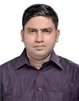
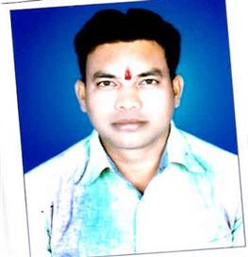
FACULTY MEMBERS
AMRITESH SHUKLA(GUEST LECTURER)
CHANDRASHEKHAR DEWANGAN(GUEST LECTURER)

Slide 5
TOTAL SANCTIONED POSTS
PROFESSOR: 01
ASSISTANT PROFESSOR: 01
CURRENT POSITION OF POSTS
PROFESSOR: VACANT
CURRENTLY MR. AMRITESH SHUKLA AND MR. CHANDRASHEKHAR DEWANGAN ARE WORKING AGAINST THESE POSTS AS GUEST LECTURERS.

Slide 6
SPECIAL FEATURES OF DEPARTMENT
Guest lecturer Amritesh Shukla has been selected in Chhattisgarh PSC Assistant Professor Exam(Rank 3).
He is pursuing Ph.D. from HEMCHAND YADAV VISHWAVIDYALAYA, DURG.
He is UGC NET and CG SET qualified.
Guest Lecturer Chandrashekhar Dewangan is pursuing Ph.D. from HEMCHAND YADAV VISHWAVIDYALAYA, DURG.

Slide 7
Achievements
Student Anju Bairagi attended Pre-R.D.C. Camp of N.S.S. in the academic session 2019-2020.
3 Students : Rajat Dewangan, Anju Bairagi and Anju Chhekar received N.S.S. “C” certificate in the academic session 2019-2020.
Student Bhawana secured university rank 10 in the academic session 2018-19.
Preeti Varma secured 3rd university rank in the academic session 2014-15.
Praveen Kaushik secured 7th university rank in the academic session 2009-10.
Chandrashekhar Kashyap secured 2nd university rank in the academic session 2007-08.

Slide 8
VISION
The Political Science department seeks to empower youth and provide quality education that will equip them to face future challenges and make them responsible and proactive citizens with democratic values.

Slide 9
Mission
To teach democratic values.
To inculcate critical thinking among young minds thereby helping them to achieve academic excellence.
To create an effective-teaching learning environment that enables the students to realise their full potential.
To inculcate a sense of environmental responsibility and philanthropic values among students so that they understand their duty towards community.

Slide 10
GOALS
To develop constitutional values like democracy, secularism, liberty, equality and fraternity among the students.
To inculcate knowledge about political theory and philosophy.
To prepare students for competitive exams.
To develop research aptitude among students.

Slide 11
Objectives
To inculcate research skills among the students to meet environmental, social and political challenges.
To develop and increase self-learning skills among students.
To promote quality in education and constantly strive for excellence in teaching, research and student support.
To enable students to play a pivotal and catalytic role in political process of country by providing them pragmatic knowledge of subject.

Slide 12
Core values
Inculcate the knowledge of Political concepts
Develop knowledge in Political Science through research and academic inquiry
Cultivate democratic values so as to promote responsible citizenship
Apply the knowledge of Political Science practically to serve society and community as a whole

Slide 13
Course outcomes

Slide 14
Undergraduate program

Slide 15
Political theory( paper code 0113)
To understand the nature scope, significance of political theory.
To acquaint with the theories, approaches, concepts and principles of political theory.
To study the definition of state, its elements evaluate the theories of origin of the state.
To know about the meaning sovereignty, types, characteristics and critically the theories of monism and pluralism.
To learn the origin of the concepts such as power, authority, and legitimacy.
To study the concept of citizenship, rights, liberty, equality and justice.
To study the concept of welfare state.

Slide 16
Indian government and politics(paper code-0114)
To understand the philosophy of Indian constitutions.
To know the salient features in making of Indian constitution and essence of preamble
To appreciate the fundamental rights and duties and the directive principle of state policy
Critically analysing the important institutions of the Indian Union and States: the Executive, the Legislature, the Judiciary, Political Parties.
To study the main issues of Indian politics like caste, religion, language, region and poverty.

Slide 17
Western political thought(paper code-0183)
To demonstrate knowledge of key thinkers and concepts like Plato, Aristotle, Machiavelli, Hegel, Green and Mill.
To acquire knowledge about modern political thinkers and theirs view on state craft.
To study the social contractualists thoughts of Hobbes, lock, and Rousseau and their view regarding state, government and general will.
To analyse the Marxist philosophy

Slide 18
Comparative Politics(paper code-0184)
Tracing the evolution of Comparative Politics as a discipline and Investigating the nature, scope and problems of Comparative Politics.
Analysing the approaches and models of comparison: systems analysis and institutional approach.
Conducting an intensive comparative study of the Executive, the Legislature the Judiciary (UK, USA and PRC and Switzerland)
To study the concepts of political socialization, political culture and political parties.

Slide 19
International Relations( paper code-0244)
To analyse definition, nature, scope approaches and study methods of international relations
To understand the various concepts like power, balance of power, collective security and diplomacy of international relations.
Understanding international issues like environment, disarmament, globalization and human rights.

Slide 20
Public Administration(Paper-0245)
The paper will introduce the students to the basic concepts of Public Administration along with its founding principles, history, nature, scope approaches, study method and new public administration.
To learn difference between public administration and private administration
To learn concepts like accountability, organization, leadership, decision, budget and communication.
To understand the concept of bureaucracy

Slide 21
Postgraduate program

Slide 22
Indian Political thought
Helping the students in accruing knowledge in the field of Indian Political thought in the initial stage of their study.
Give the students an insight into the thoughts of prominent Indian political thinkers like Kautilya, Swami Vivekanand, Mahatma Gandhi, Dr. Ambedkar, M.N. Roy, Jay Prakash Narain, Ram Manohar Lohia.

Slide 23
Indian Government and politics-1
Help studying students historical development of the Constitution, its philosophical bases, its sources and features.
To get students acquainted with knowledge of preamble fundamental rights and duties, amendment process, Union executive, union legislature, Supreme court.
Analysing issues of Indian Polity like caste, religion, language, region, Corruption and Communalism

Slide 24
Comparative politics-1
Tracing the evolution of Comparative Politics as a discipline and Investigating the nature, scope and problems of Comparative Politics.
Analysing the approaches and models of comparison: systems analysis and institutional approach.
Analysing the growth of behaviouralism and post-behaviouralism.
To study the concepts of political socialization, political culture and political communication

Slide 25
International organization
The expected outcome of the paper is to familiarise students with the workings and functioning of International Organisations , especially the United Nations and enable them to understand the different issues taken up by the UN and other regional organizations like BRICS, SAARC, ASEAN and EU

Slide 26
Western Political thought
Help analysing the thought various western political thinkers like Plato, Aristotle, Machiavelli, Hobbes, Locke, Rousseau, Mill, Hegel, Green, Marx, Lenin and Mao and their contribution to political thought.

Slide 27
Indian Government and politics-2
Help students learn in detail the state executive, state legislature, state judiciary, state finance commission, state election commission, state election commission.
Give insight into issues like demand for new states, state autonomy and interstate river disputes.

Slide 28
Comparative politics of developing countries
Help students learn classification of government, separation of powers, Political institutions, Political parties, pressure groups, bureaucracy.
Study concepts like political modernization, political development and elites.

Slide 29
Indian Foreign Policy
Help students analyse determinants of Indian foreign policy , India’s relations with UNO, its neighbours and super powers like USA, Russia and India’s response to nuclear disarmament.

Slide 30
Theory of International Relations-1
Help students understand meaning , nature scope of international politics, its theories and various concepts like power, balance of power, collective security and national interest.
To get insights into issues like nuclear disarmament, nuclear non proliferation and working of regional organizations

Slide 31
Public Administration-1
study concepts of public administration, of new public administration, Private administration and development administration.
To learn basic administrative theories like organization, centralization-decentralization, executive, recruitment, promotion training and bureaucracy

Slide 32
Research Methodology-1
To understand meaning of social research, research problem, hypothesis, research design and social survey.
To learn types of data, types of study and methods of data collection

Slide 33
Politics of Chhattisgarh-1
To help students gain knowledge about formation of Chhattisgarh state, local self government, voting behaviour and issues of Chhattisgarh like naxalism

Slide 34
Theory of International Relations-2
To help students study concepts like Non-Alignment, Cold war and issues like globalization, human rights, terrorism and environment.
To help students understand foreign policies of various countries like USA, China, Russia

Slide 35
Public Administration-2
To help students analyse various concepts of financial administration, personnel administration, administrative behaviour and issues like corruption and lokpal

Slide 36
Research Methodology-2
Help students get insights into details of research like sampling, classification, analysis and interpretation of facts and use of statistics

Slide 37
Politics of Chhattisgarh-2
Help students learn historical and geographical background of Chhattisgarh, administration in the state from 1857 till 2000, independence movement in the state and prominent personalities of the state.

Slide 38
Program outcome

Slide 39
Undergraduate program
Demonstrate an understanding of fundamental political processes, institutions, actors, behaviour, and ideas; and familiarity with major theories, methods, and concepts of Political Science.
Service to people by opting for civil services.
To create values of patriotism among youth.
Demonstrate a proficiency in thinking systematically about political interactions in national, global and international contexts.
Write effectively, engage in intellectually grounded oral debate, and form and express coherent arguments.

Slide 40
Postgraduate program
Demonstrate proficiency in thinking systematically about the ethical dimensions of Politics. Synthesize, analyse, and critically evaluate major arguments in the discipline.
Comprehend the basic structures and processes of government systems and/or theoretical underpinnings.
Analyse political problems, arguments, information, and/or theories.
Apply methods appropriate for accumulating and interpreting data applicable to the discipline of political science.
Show deep understanding of politics of Chhattisgarh state.
Service to the field of higher education and research by opting a career in education or research.

Slide 41
Teaching methodology
Classroom teaching( chalk and duster)
Group discussion
Departmental seminar
PowerPoint presentations
ICT enabled teaching

Slide 42
Future Plans

Slide 43
Future Plan For Next Five Years
To develop UGC NET/SET, Union and State Civil Services guidance for the students.
To establish an enriched Departmental Library.
To develop ITC infrastructure in the Department for enabling modern teaching techniques.
To develop research environment among departmental faculty.
To endeavour for National Level Seminar.

Slide 44
ENROLLMENT DETAILS

Slide 45
YEAR-WISE ENROLLMENT IN POSTGRADUATE CLASSES
YEAR | M.A. –I SEMESTER | M.A. –III SEMESTER
2015-16 | 18 | 13
2016-17 | 20 | 14
2017-18 | 20 | 16
2018-19 | 20 | 17
2019-20 | 20 | 16

Slide 46
EXAM RESULT OF M.A.-POLITICAL SCIENCE
YEAR | ENROLLED | APPEARED | PASS | RESULT
2014-15 | 16 | 16 | 14 | 87.50%
2015-16 | 13 | 13 | 13 | 100.00%
2016-17 | 14 | 13 | 13 | 100.00%
2017-18 | 16 | 16 | 16 | 100.00%
2018-19 | 17 | 17 | 15 | 88.24%
2019-20 | 16 | 15 | 14 | 93.33%

Slide 47
RESULT 2015-16
CLASS | APPERAED | PASS | FAIL | ABSENT
B.A. I | 176 | 140 | 35 | 01
B.A. II | 152 | 144 | 03 | 05
B.A. III | 85 | 83 | 01 | 01

Slide 48
RESULT 2016-17
CLASS | APPEARED | PASS | FAIL | ABSENT
B.A. I | 205 | 183 | 19 | 03
B.A. II | 118 | 117 | 01 | 00
B.A. III | 64 | 63 | 01 | 00

Slide 49
RESULT 2017-18
CLASS | APPEARED | PASS | FAIL | ABSENT
B.A. I*(05 Supp) | 193 | 176 | 06 | 06
B.A. II | 184 | 180 | 03 | 01
B.A. III | 117 | 116 | 01 | 00

Slide 50
RESULT 2018-19
CLASS | APPEARED | PASS | FAIL | ABSENT
B.A. I | 179 | 165 | 11 | 03
B.A. II*(12 Supp, 1 WH) | 205 | 167 | 25 | 00
B.A. III | 193 | 192 | 01 | 00

Slide 51
RESULT 2019-20
CLASS | APPEARED | PASS | FAIL | ABSENT
B.A. I | 193 | 193 | 00 | 00
B.A. II | 191 | 191 | 00 | 00
B.A. III | 186 | 186 | 00 | 00

Slide 52
RESULT ANALYSIS

Slide 60
ALUMNI

Slide 61
S.No. | NAME | OCCUPATION
1. | Chandrashekhar Kashyap | Assistant Board Manager
2. | Jitendra Kashyap | Lecturer
3. | Manoj Verma | Lecturer
4. | Pawan | Lecturer
5. | Babulal Sahu | Lecturer
6. | Santoshi Thakur | Lecturer
7. | Sati Thakur | Lecturer
8. | Chandrashekhar Dewangan | Guest Assistant Professor
9. | Umashankar Nirmalkar | JBS Member/Politics
10. | Hemant Baghel | Politics
11. | Moti Baghel | Contractor/ Politics

Slide 62
S.No. | NAME | OCCUPATION
12. | Bhawishya Jain | Politics
13. | Sanjay Chandrakar | Computer Operator
14. | Mukesh Nirmalkar | Computer Operator
15. | Praveen Kaushik | Computer Operator
16. | Vivek Bhale | Armed Forces
17. | Doctor Sinh Tandon | Armed Forces
18. | Tamradhwaj Verma | Police
19. | Virendra Verma | Agriculture

Slide 63
PROGRAMS ORGANIZED

Slide 64
S.No. | Date of Program | Name of program | Participants
1. | 06/09/2018 | Welcome of Freshers | Ma I and M.A. III
2. | 26/11/2018 | Constitution Day | MA and BA (all classes)
3. | 25/01/2019 | National Voters’ Day | MA II and IV Sem
4. | 27/02/2019 | Educational Tour of State legislative Assembly | MA II and IV Sem
5. | 04/04/2019 | Farewell of final semester students | MA II and IV Sem
6. | 27/09/2019 | Welcome of Freshers | Ma I and M.A. III
7. | 11/11/2019 | Lecture on article 370 Formation Political science Council | MA and BA (all classes)
8. | 13/11/2019 | Departmental Seminar | Ma I and M.A. III
9. | 26/11/2019 | Constitution Day | MA and BA (all classes)
10. | 10/12/2019 | World Human Rights Day | MA and BA (all classes)
11. | 22/01/2020 | Lecture on Fundamental duties | MA and BA (all classes)

Slide 65
MEMORABLE EVENTS

Slide 66
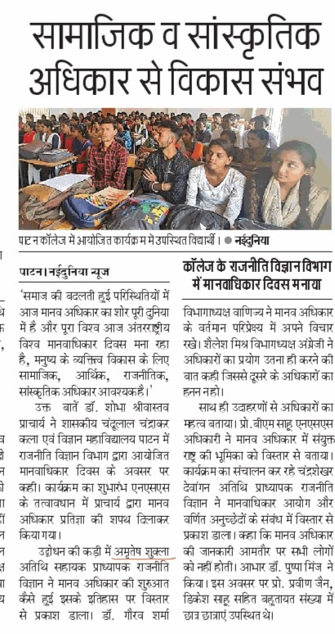
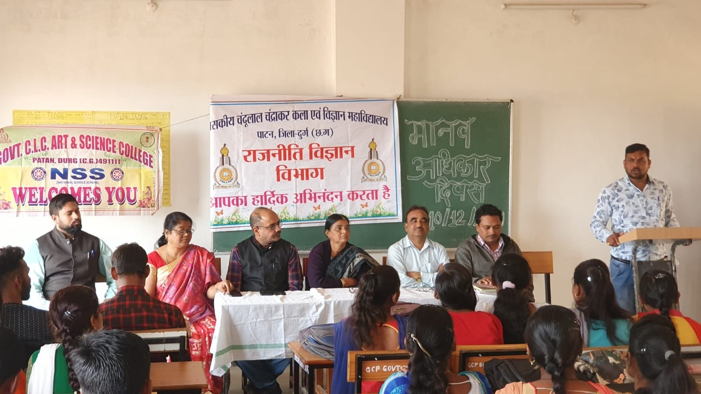
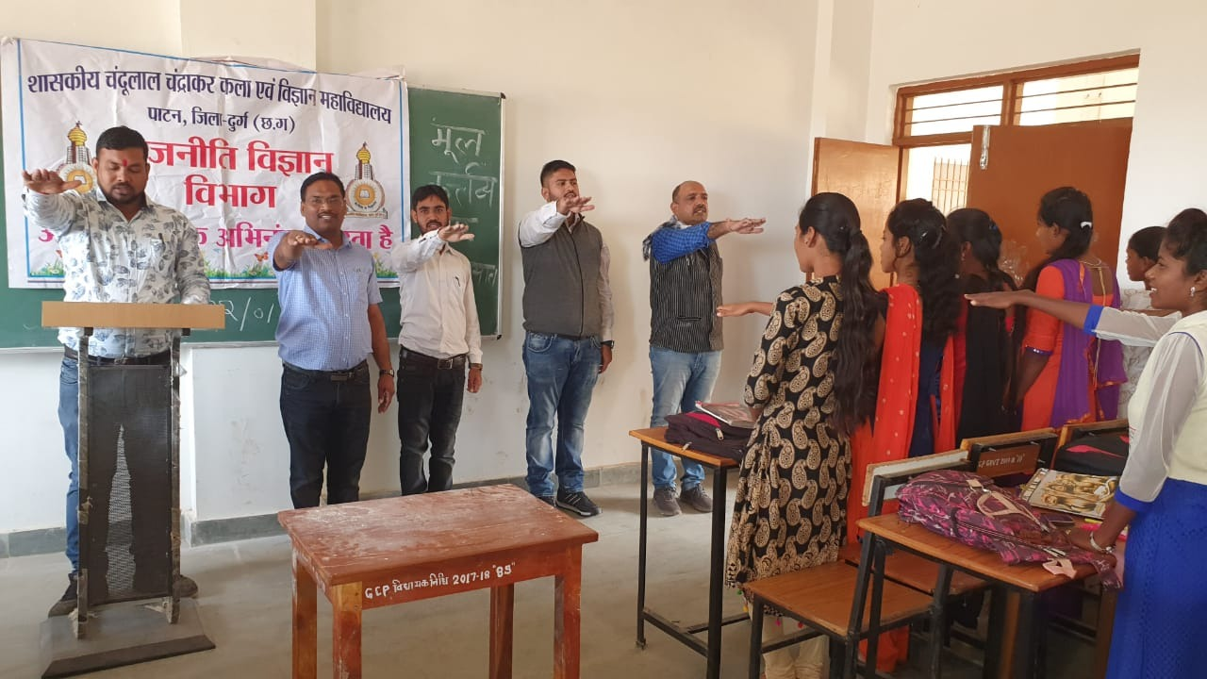

Slide 68
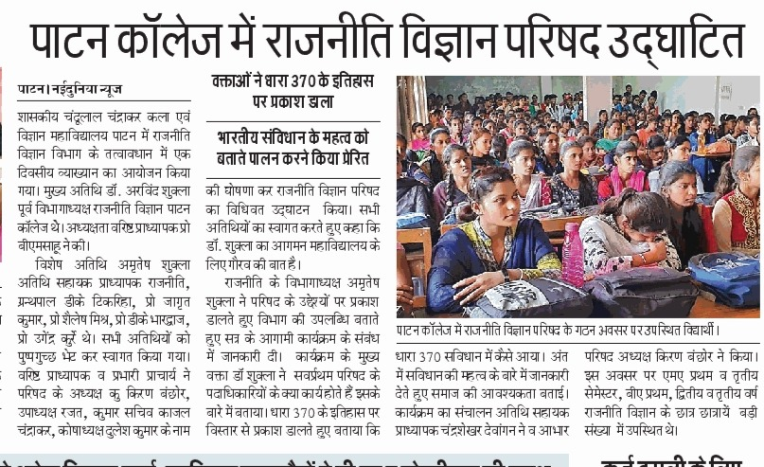
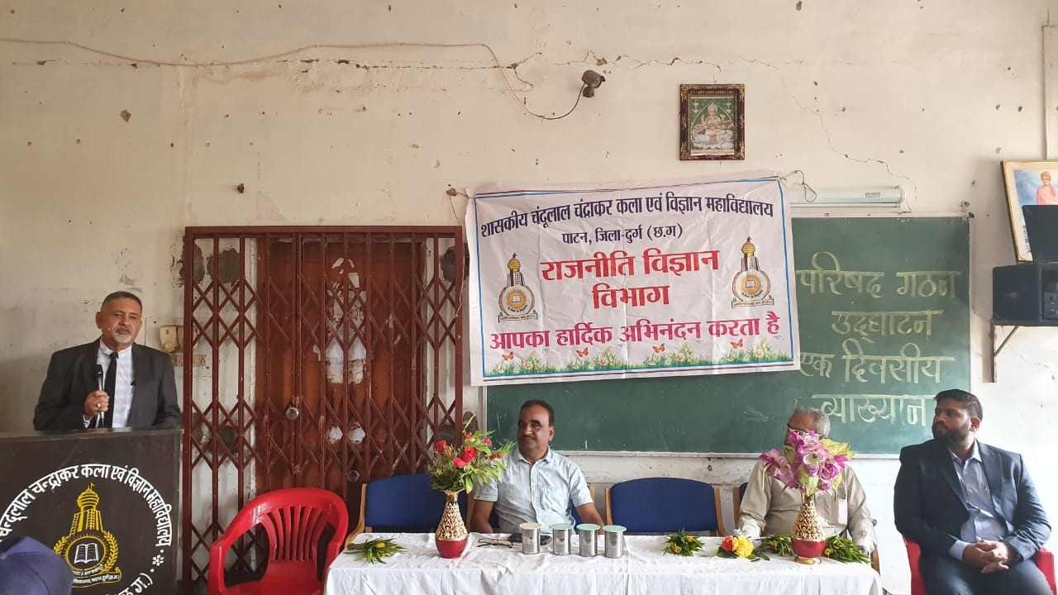

Slide 69
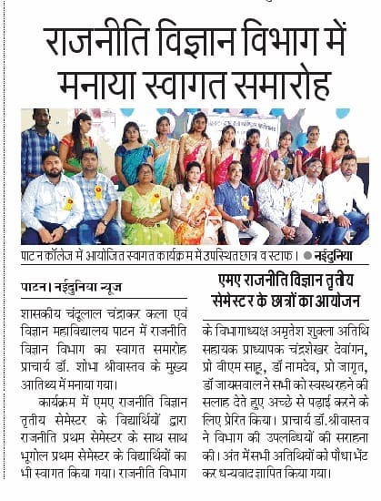
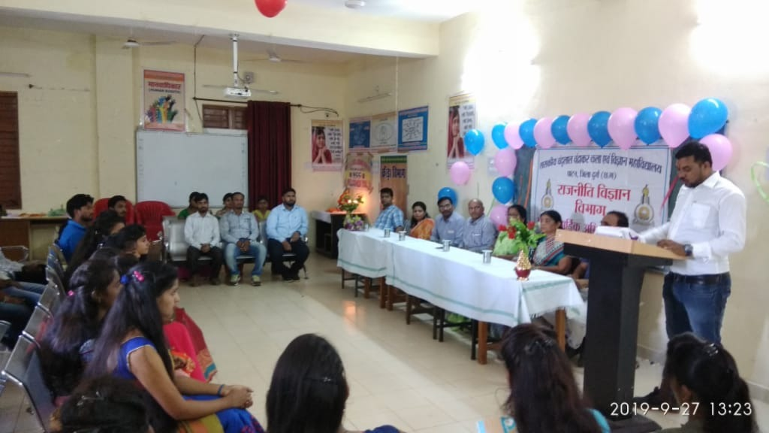

Slide 70
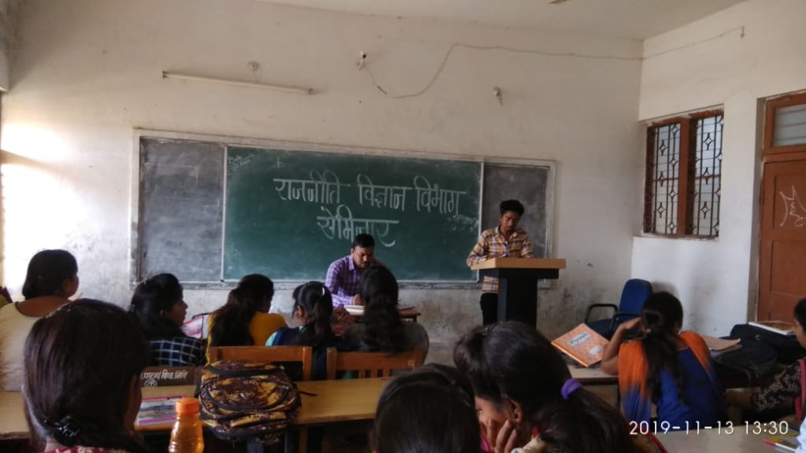
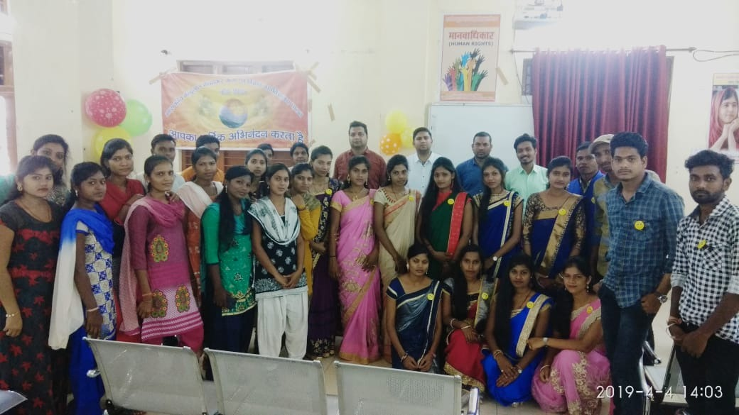

Slide 71
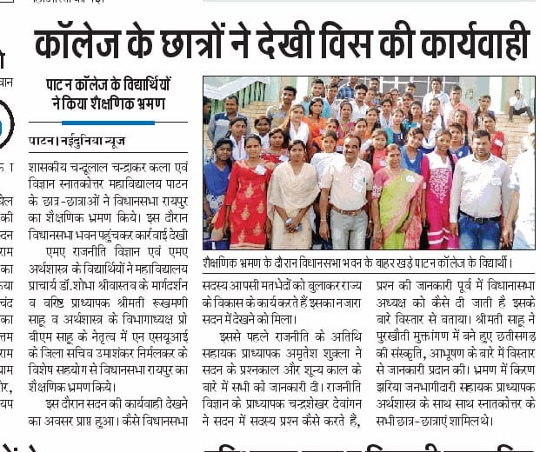
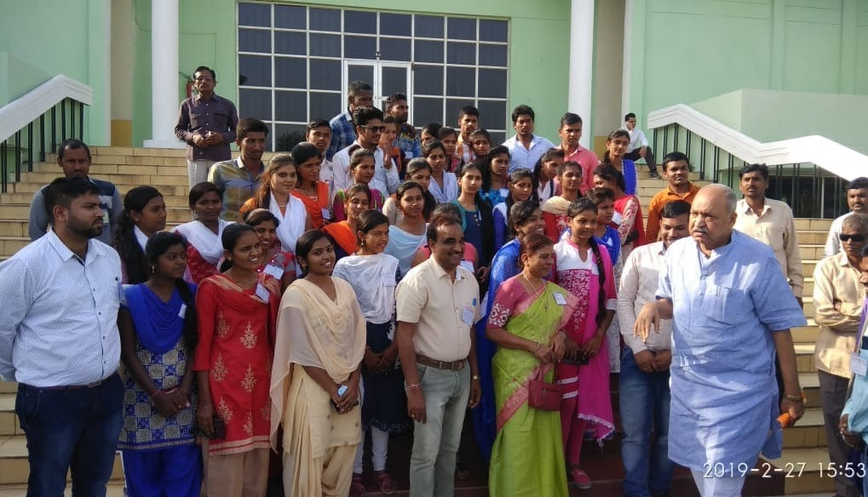

Slide 72
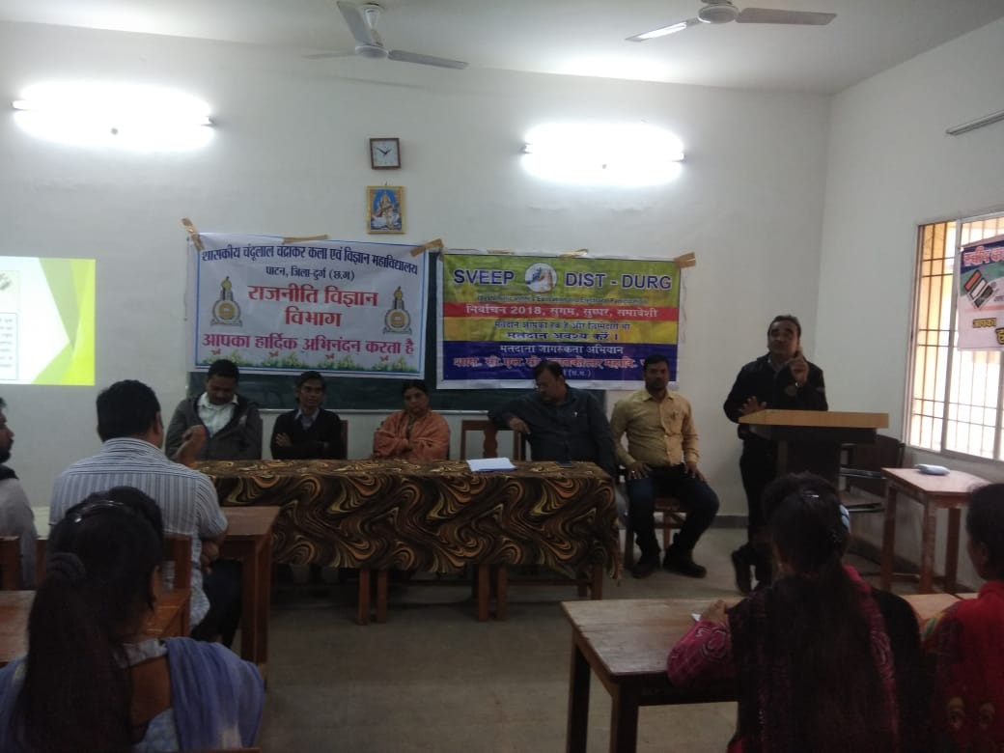
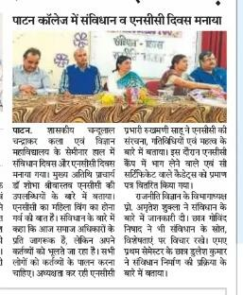
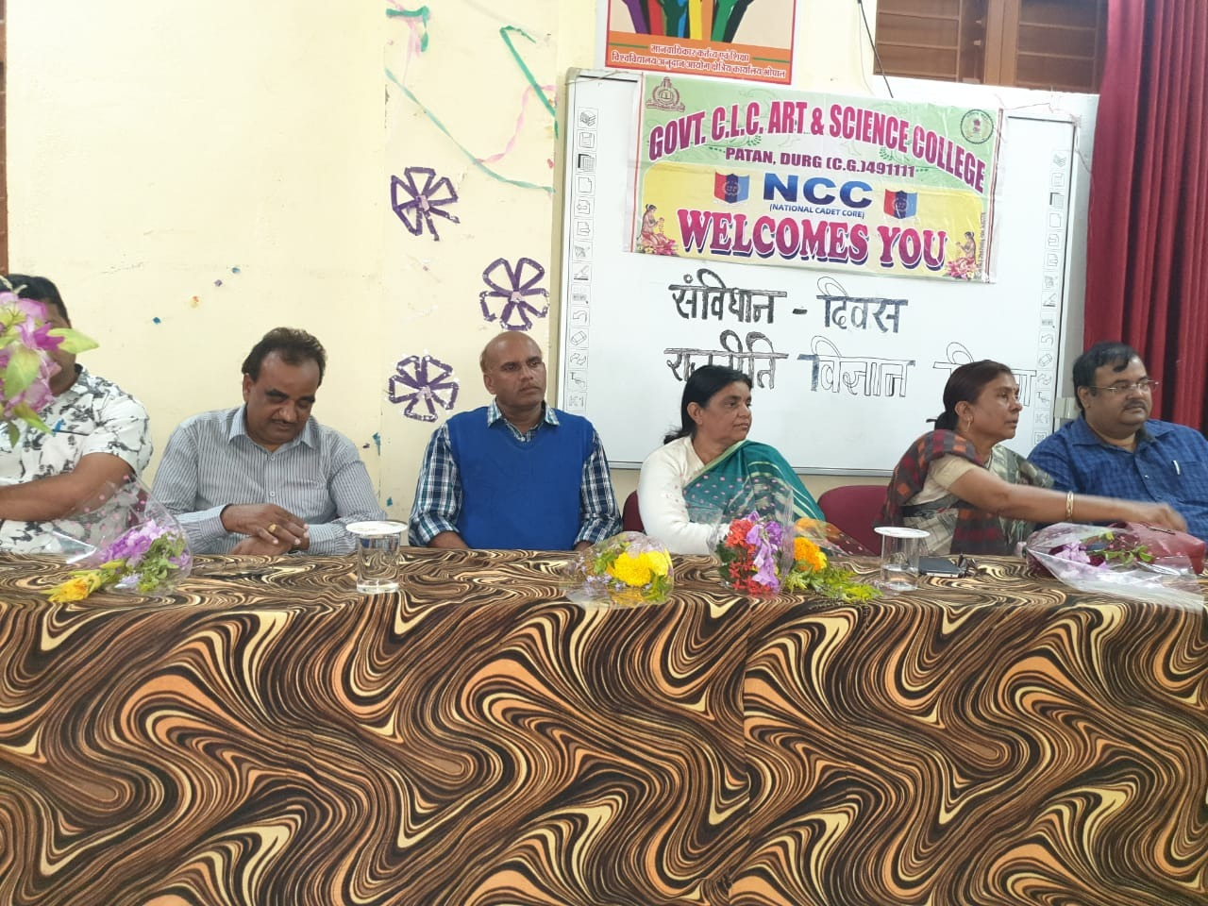

Slide 73
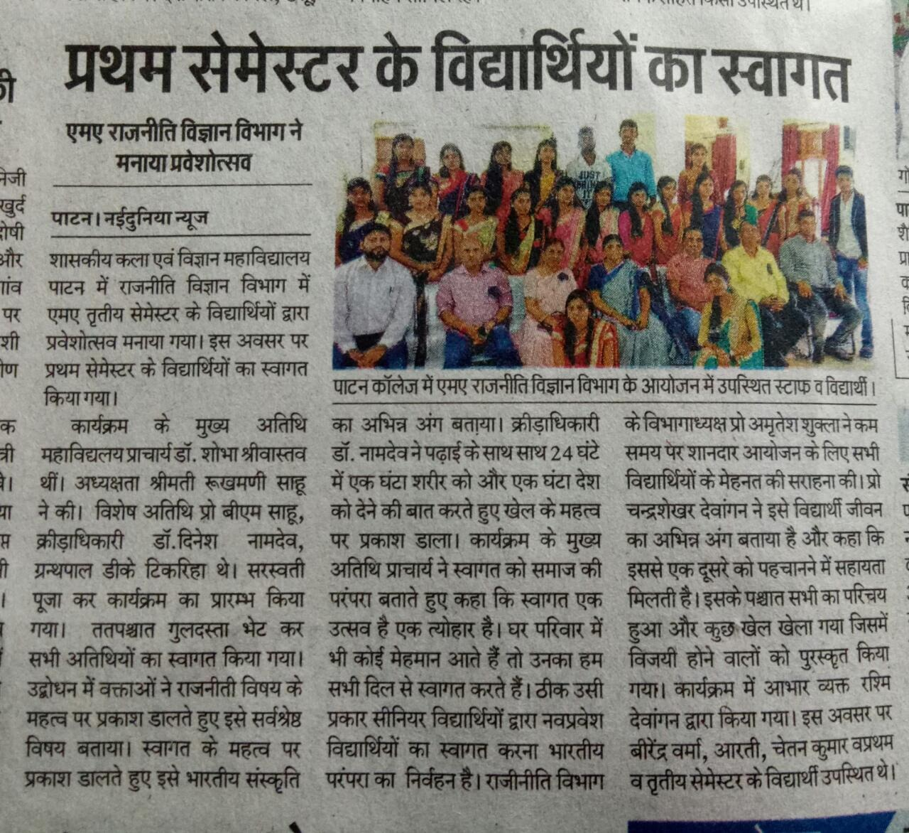
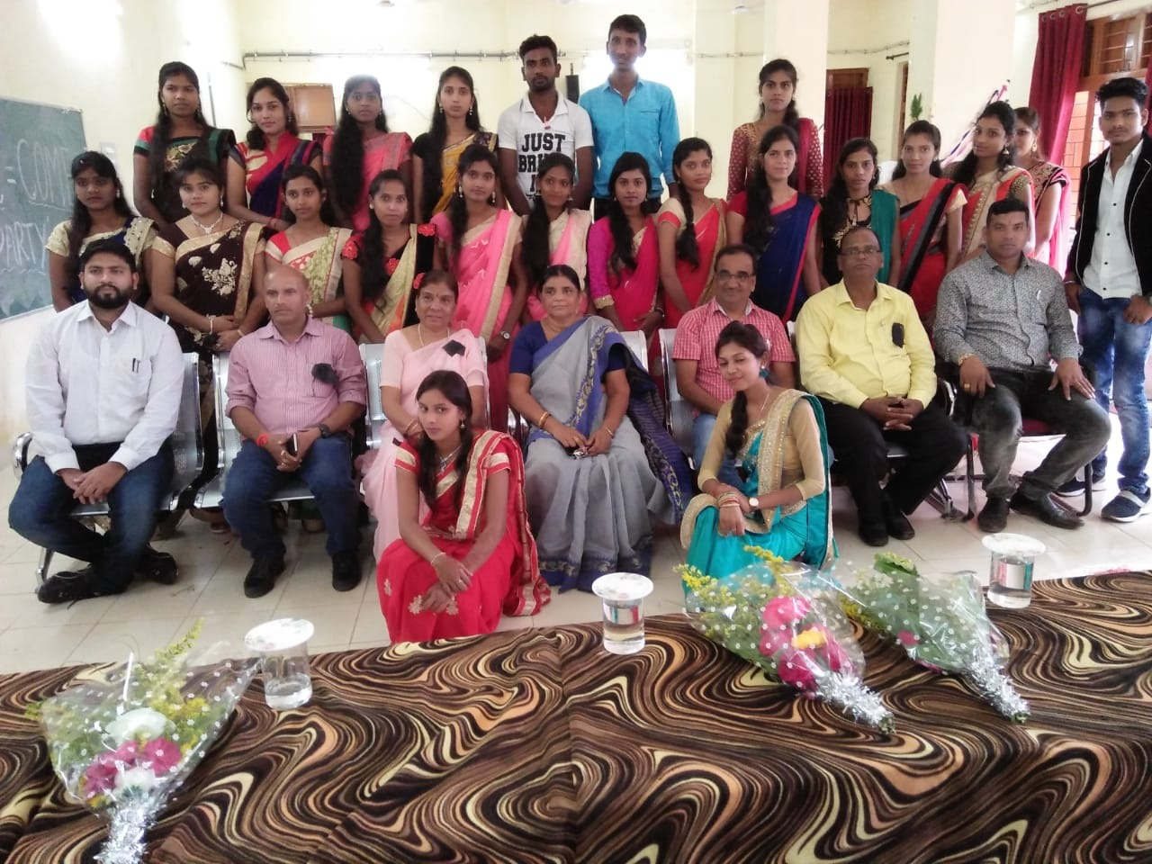

Slide 74
THANK YOU

